Slide 1


Data
Analysis

Slide 2


Today's agenda
Project recap
Problem
The Analytics team
Process
Insights
Summary

Slide 3

Social buzz is the fastest growing technology unicorn that need to adapt quickly to its global scale
Accenture has begun a 3 months POC focusing on
These tasks:
An Audit of social Buzz’s Big data practice
Recommendation for successful IPO
Analysis to find Social Buzz’s top 5 most popular categories of content
Project Recap

Slide 4

Problem
Over 100000 posts per day
36500,000 pieces of content per year
But how to capitalize on it when there is so much?
Analysis to find social Buzz; top 5 most popular categories
Of the content.

Slide 5


Data
Analyst
ADARSH

Slide 6
Process
1
Data understanding
2
Data cleaning
3
Data Modelling
4
Data Analysis
5
Uncover Insights

Slide 7

Insights
16
UNIQUE
CATEGORIES
1897
REACTION TO “ANIMAL” POSTS
JANUARY
MONTH WITH MOST POSTS

Slide 8
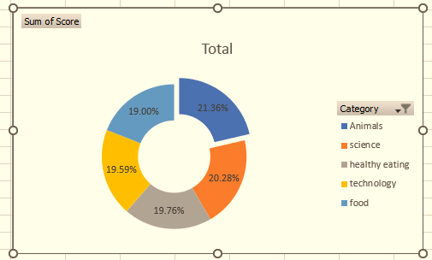
Top 5 categories by popularity share

Slide 9
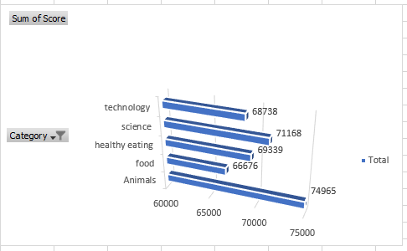
Top 5 category by aggregate score

Slide 10

ANALYSIS
Animals and the Science are the two most popular categories of content , showing that people enjoy “real life” and “factual” content of the most
INSIGHT
Food is the common theme with the top 5 categories with “ Healthy Eating “ ranking the highest . This may give an indication to the audience within your user base . You could use this insight to create an campaign and work with healthy eating brands to boost user engagements.
Summary

Slide 11
Thank you!
ANY QUESTIONS?

